Slide 1

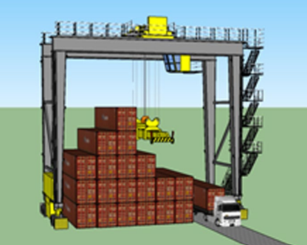
A metaheuristic approach to the Container Relocation Problem (CRP)

Slide 2
Abstract
Based on a prior papers of Livia Maglic (2019) and Marko Gulic (2022) and other.
Our study uses genetic algorithms(GA) with new relocation rules.
Reduce the average number of relocation of blocking containers.
Ensure the balance of the bay during retrieving process
Reduce the horizontal movement of the crane trolley.

Slide 3
1. CRP description

Slide 4
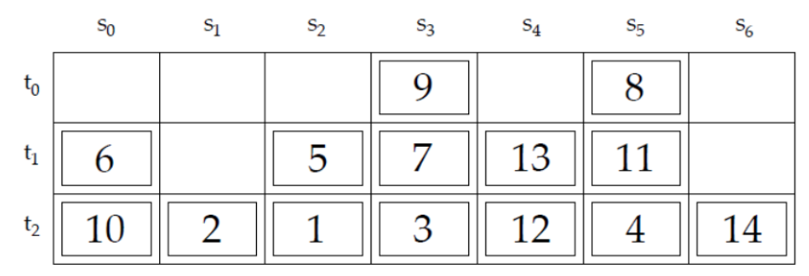
CRP description
Crane trolley
A container bay at a terminal seaport.
Containers are stacked side by side and on top of each other.
Each container has a unique priority number based on retrieving time.
Blocking containers.
Marko Gulic (2022)

Slide 5
CRP description (cont’d)
Caserta (2011):
The objective of the CRP is to retrieve all the containers from the bay in the prescribed order while minimizing the number of rehandling operations.
Livia Maglic(2019):
The CRP focuses to find the best sequence of rules to retrieve all the containers within the given bay (respecting their priority) with the minimum number of relocations
Marko Gulic(2022):
Minimizing the total number of container relocations within the bay and thus speeding up container retrieval.

Slide 6


Slide 7
CRP description (cont’d)
NP-hard problem (Caserta (2011))
Can be solved effectively by using metaheuristic algorithms
GA (Livia Maglic. (2019), Marko Gulic(2022)
Tabu search (Wu & Ting, 2010)
Simulated annealing (ElWakil et al. (2019)
Ant colony optimization (Jovanovic et al. (2019)
Pilot method (Tricoire et al. (2017)
…

Slide 8
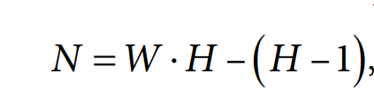
CRP description (cont’d)
Assumptions:
Focus on a 2-dimensional bay.
Static: no new container arrival is allowed during the retrieval process.
Offline: retrieval times are known in advance.
All containers are full and the same size (1 TEU)
The minimum number of empty space on the bay:
Restricted variant: only the relocation of blocking containers is allowed.
Wu, Ting (2010)

Slide 9
2. CRP solutions

Slide 10
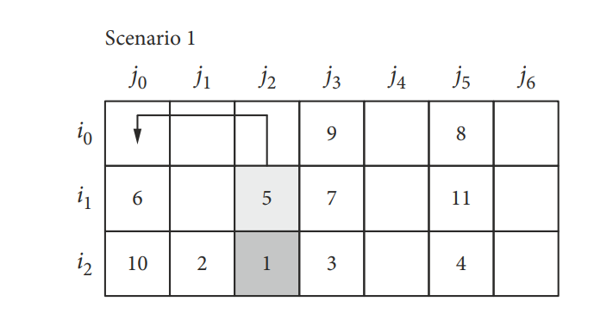
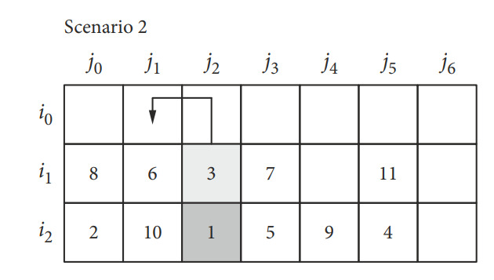
Livia Maglic(2019): propose 4 rules + GA
R1: relocate the container to the nearest stack in which all containers will be retrieved later than the blocking container.

Slide 11
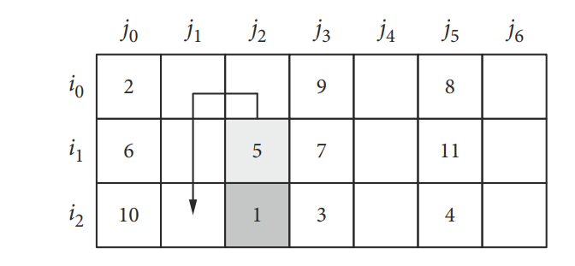
4 rules (cont’d)
R2: relocate the container to the nearest empty stack

Slide 12
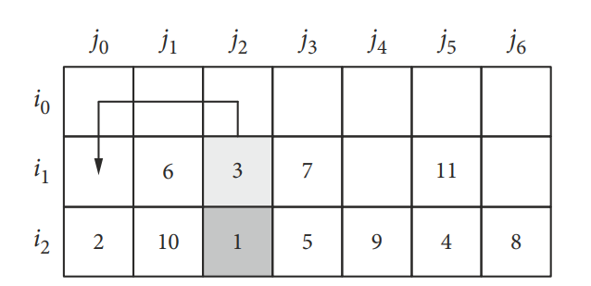
4 rules (cont’d)
R3: relocate the container to the nearest and the lowest stack.

Slide 13
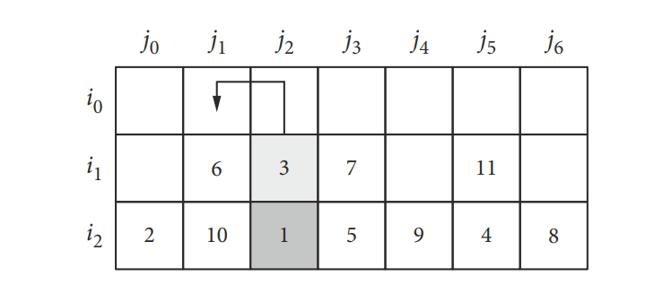
4 rules (cont’d)
R4: relocate the container to the nearest stack that is not full to the maximum stacking height

Slide 14
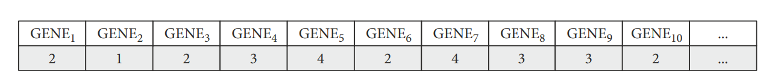
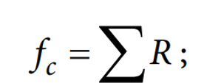
The model in the GA
Chromosome
Fitness function:
Population: is randomly generated 8000 chromosomes

Slide 15
The model in the GA (cont’d)
Selection:
Each chromosome is evaluated with the fitness function
The number of the fittest chromosomes that propagate to the next generation is set at 50% (4000 chromosomes) of the population size
Crossover:
Single-point crossover is used.
Crossover position is randomly determined.
Mutation: use simple mutation

Slide 16
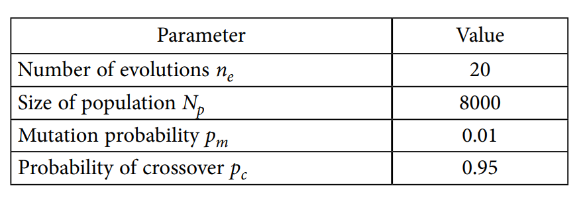
The model in the GA (cont’d)
Parameters:

Slide 17
3. Improve MAGLIC paper

Slide 18
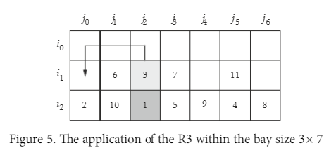
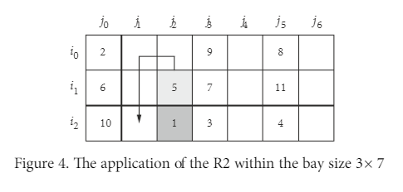
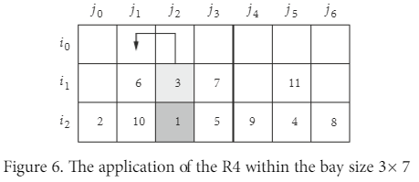
Some disadvantages of the original paper
Blocking containers tend to be relocated to the left of the bay → can establish unbalanced status.
→ Solution: random relocate blocking container to the left or right.

Slide 19
Some disadvantages of the original paper
In some cases, rules are not optimize:
→ Solution: edit rule 3.

Slide 20
Results

Slide 21
Dataset
Random generate 40 instance sets of data, following the guidline in Wu, Ting (2010)
The bay sizes in Maglic are (3×3 ... 6×3, 3×4 ... 6×4, 3×5 ... 6×5, 3×6 ... 6×6, 3×7 ... 6×7)
We random generate BIG bay sizes
The bay sizes (3x8…6x8, 3x9…6x9, 3x10…6x10)

Slide 22
Test method
Run MAGLIC’s method on our instances
Run our method with rule improvement on our instances.

Slide 23
Result on BIG bay sizes
Bay sizes (Tiers x Stacks) | Average number of relocation of MAGLIC et al | Our result | Percentage
3 x 8 | 14,79 | 14,68 | 0,8%
4 x 8 | 9,94 | 9,70 | 2,4%
5 x 8 | 13,46 | 13,38 | 0,6%
6 x 8 | 26,68 | 26,71 | -0,1%
3 x 9 | 22,20 | 22,14 | 0,2%
4 x 9 | 25,41 | 25,54 | -0,5%
5 x 9 | 47,14 | 47,03 | 0,2%
6 x 9 | 35,20 | 35,06 | 0,4%
3 x 10 | 38,78 | 38,77 | 0,0%
4 x 10 | 62,96 | 62,75 | 0,3%
5 x 10 | 49,86 | 49,84 | 0,0%
6 x 10 | 57,03 | 56,84 | 0,3%

Slide 24
Result on small bay sizes
Bay size (Tiers x Stacks) | Our result | MAGLIC 2019 | Percentage
4×3 | 4,90 | 4,87 | -0,8%
5×3 | 7,07 | 7,11 | 0,6%
6×3 | 8,43 | 8,46 | 0,3%
3×4 | 9,82 | 9,90 | 0,8%
4×4 | 6,32 | 6,32 | 0,1%
5×4 | 8,87 | 8,95 | 0,8%
6×4 | 12,79 | 12,83 | 0,4%
3x5 | 15,02 | 15,04 | 0,1%
4x5 | 18,12 | 18,12 | 0,0%
5x5 | 10,59 | 10,65 | 0,6%
6x5 | 14,16 | 14,09 | -0,5%
3x6 | 19,89 | 19,95 | 0,3%
4x6 | 23,90 | 23,94 | 0,2%
5x6 | 29,01 | 29,00 | -0,1%
6x6 | 14,22 | 14,35 | 0,9%
3x7 | 19,22 | 19,31 | 0,5%
4x7 | 27,84 | 27,93 | 0,3%
5x7 | 34,91 | 34,87 | -0,1%
6x7 | 43,09 | 43,08 | 0,0%

Slide 25
Future research
Test on the improvement of balanced bay (randomly choose to relocate a container to the left or to the right of the bay)
The result is worse than MAGLIC’s algorithm
Why? → Because this improvement is only to ensure the balance of the bay, not to reduce the total number of relocation.

Slide 26
Before, we edited rule 3 (relocate to the nearest stack that has no blocking container) and get the better result.

Slide 27
New idea
Because containers are continually taken by the truck, so from time to time we will have more and more empty spaces to relocate. So, we “have the right” to choose the good space in each relocation.
→ Edit rule 4 in MAGLIC’s paper
Original rule 4: relocate the container to the nearest and not full stack
Update: choose to relocate the container to the nearest, not full and no blocking containers stack
The result is better than just only edit rule number 3
Why? Because we choose the better relocation in each step → the global result is better
Summary
We should edit both rule 3 and rule 4 in MAGLIC’s paper to get considerably better result.

Slide 28
Thank you for listening!

